Slide 1
Geographic, Experiential, and Productivity Trends in Data Jobs
Nakonde Ronah Precious

Slide 2
About the datasets
This presentation examines trends in data jobs, particularly focusing on geographic and experiential factors and their impact on productivity. The study leverages data from Kaggle to address evolving job patterns in the data industry.
Two datasets were analyzed: one with data science job entries (9355 rows, 12 columns) and another with employee work patterns and productivity (1000 rows, 5 columns).
The first dataset provides insights into roles, salaries, locations, and employment types in data science.
The second dataset explores remote versus in-office employment, hours worked, productivity scores, and well-being scores.
The analysis aims to understand the impact of remote work on productivity and the broader implications for global job trends in tech.
My motivation for exploring data sets on job trends in data arises from the recent wave of layoffs in the tech industry during 2023-2024. This situation has sparked a debate among major tech CEOs, who argue that remote work diminishes productivity and that the same level of output can be achieved when employees are in the office. I aim to investigate whether this claim holds true by analyzing job trends in data science.

Slide 3
Jobs Data Overview
job_category | total_count
Data Science and Research
Data Engineering
Data Analysis
Machine Learning and AI
Leadership and Management
BI and Visualization
Data Architecture and Modeling
Data Management and Strategy
Data Quality and Operations
Cloud and Database
This table shows that “Data Science and Research” is the category with the most opportunities, while “Cloud and Database” has the least.

Slide 4
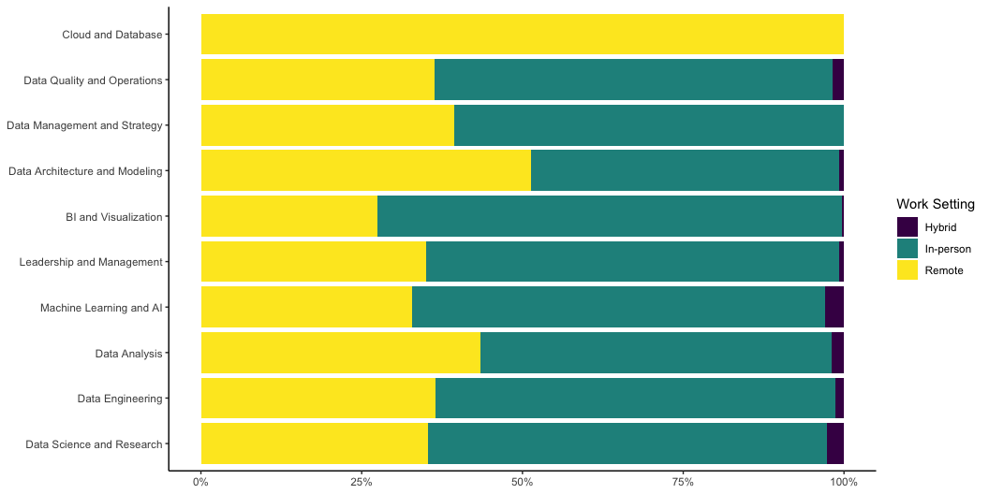
Distribution of Work Settings Amongst Job Categories

Slide 5
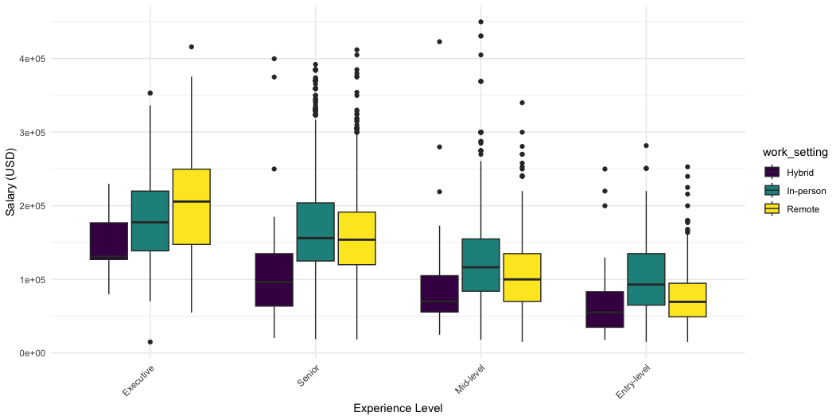
Salary Distribution by Experience level and Work Setting

Slide 6
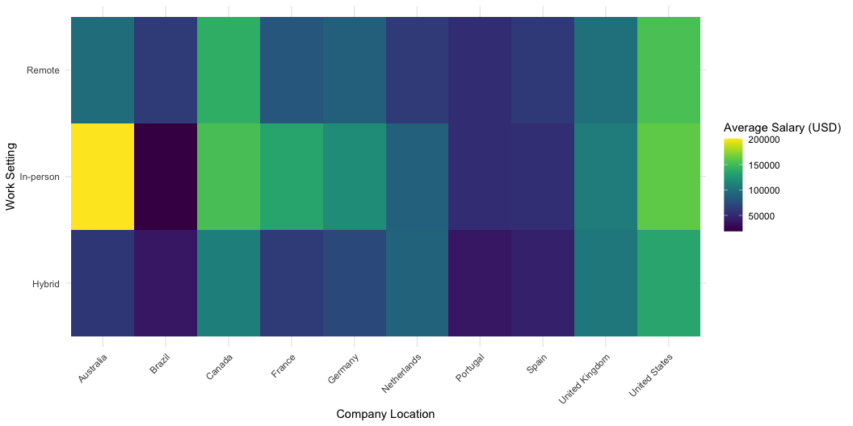
Average Salary Heatmap by Company Location and Work Setting

Slide 7
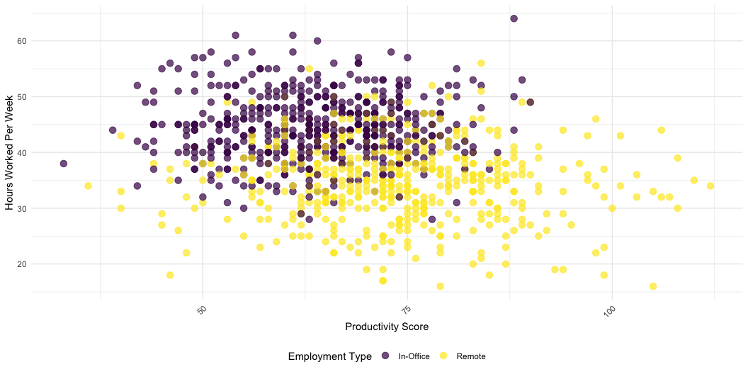
Relationship Between Hours Worked and Productivity

Slide 8
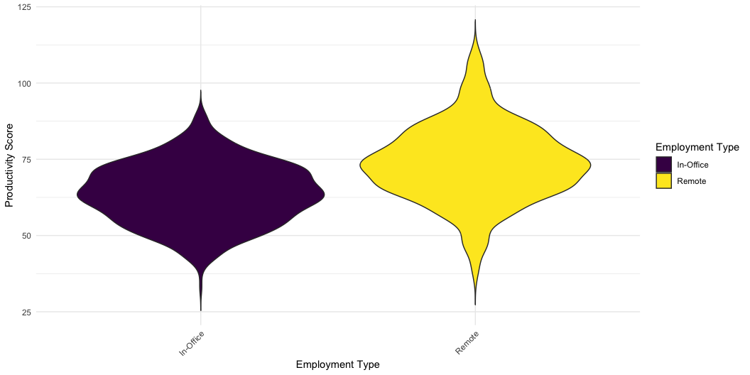
Productivity Score Distribution by Employment Type

Slide 9
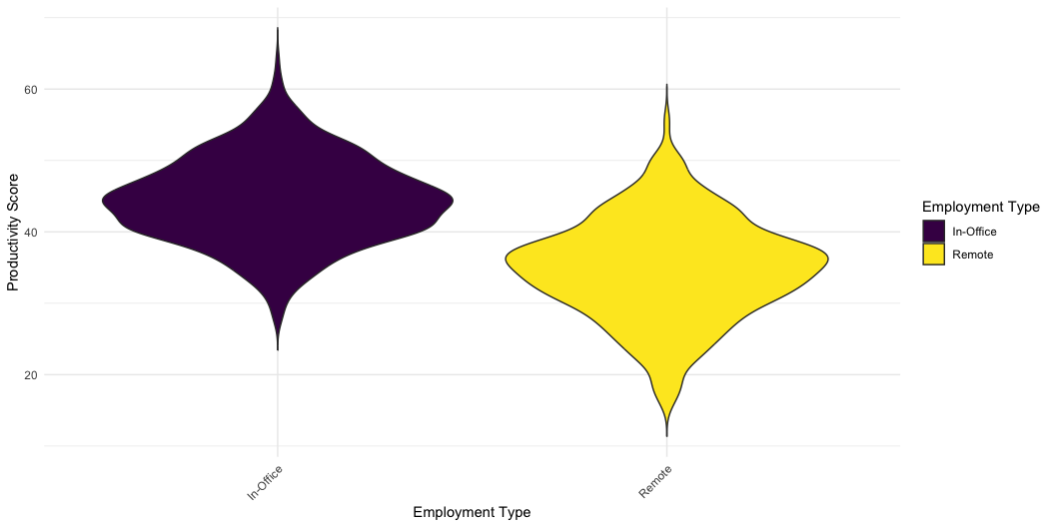
Productivity Score Distribution by Employment Type

